Slide 1

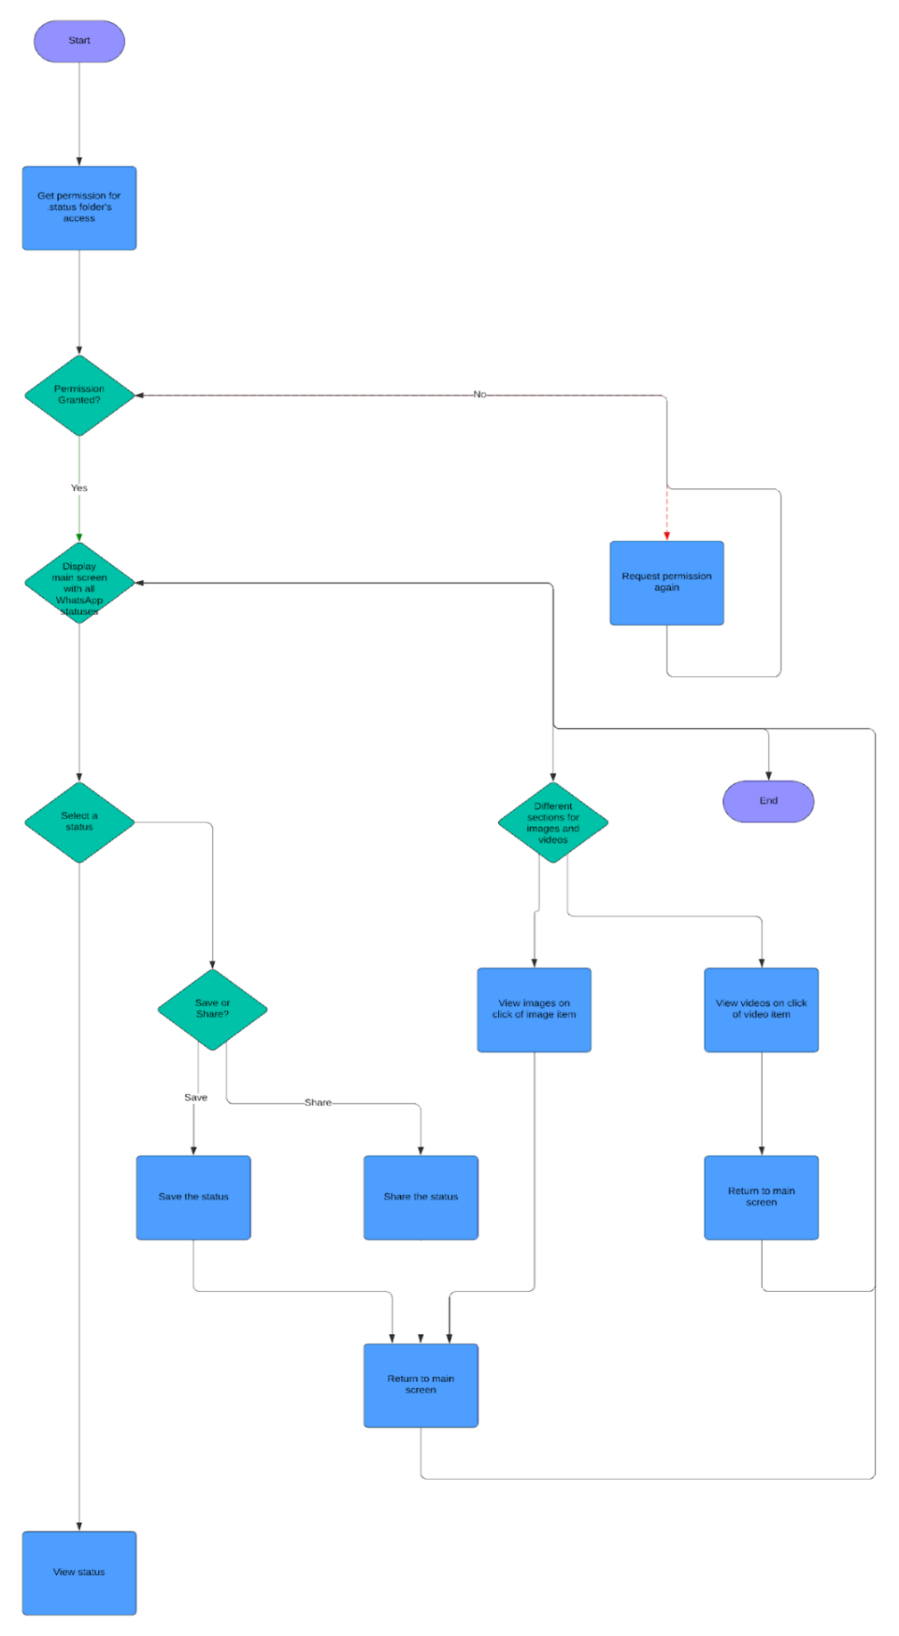
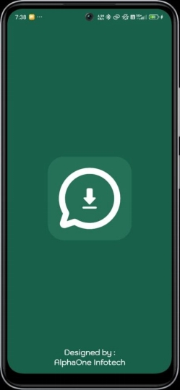
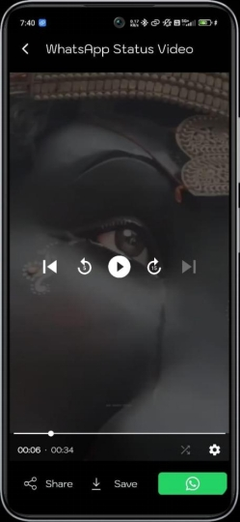
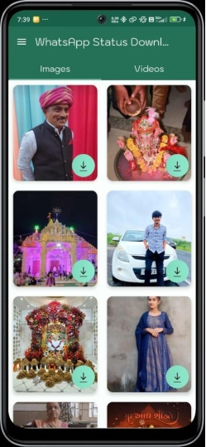
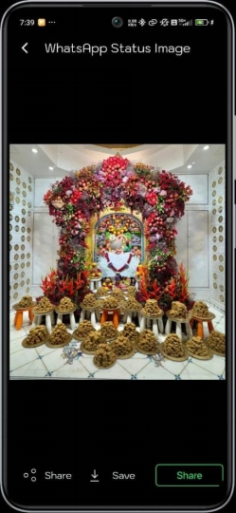
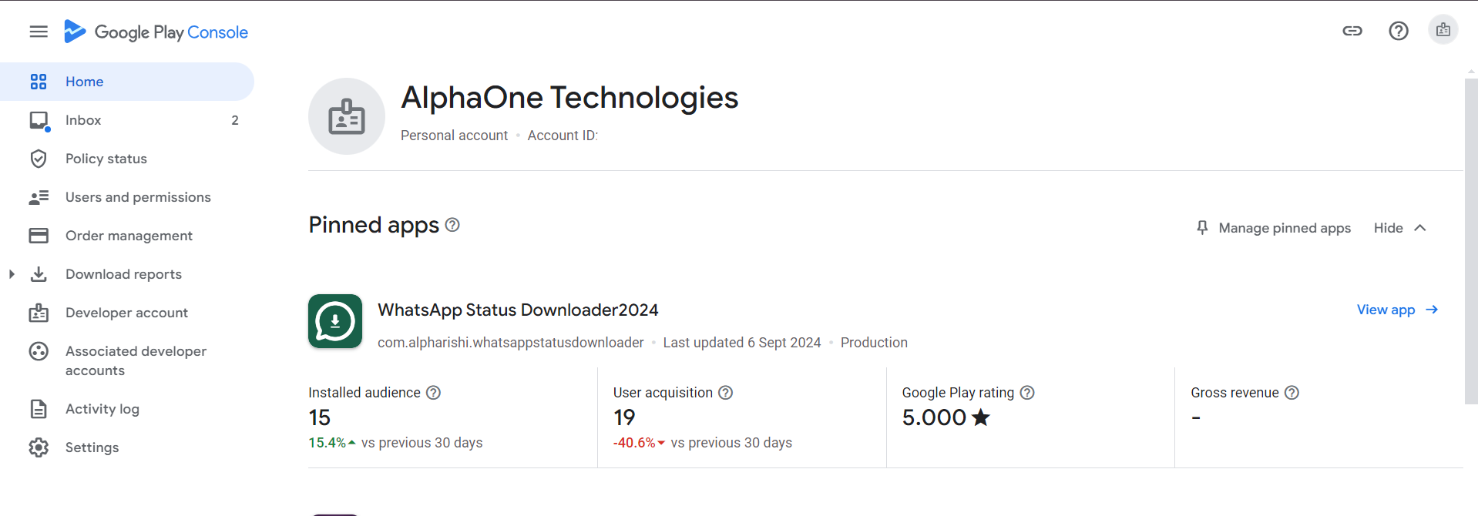
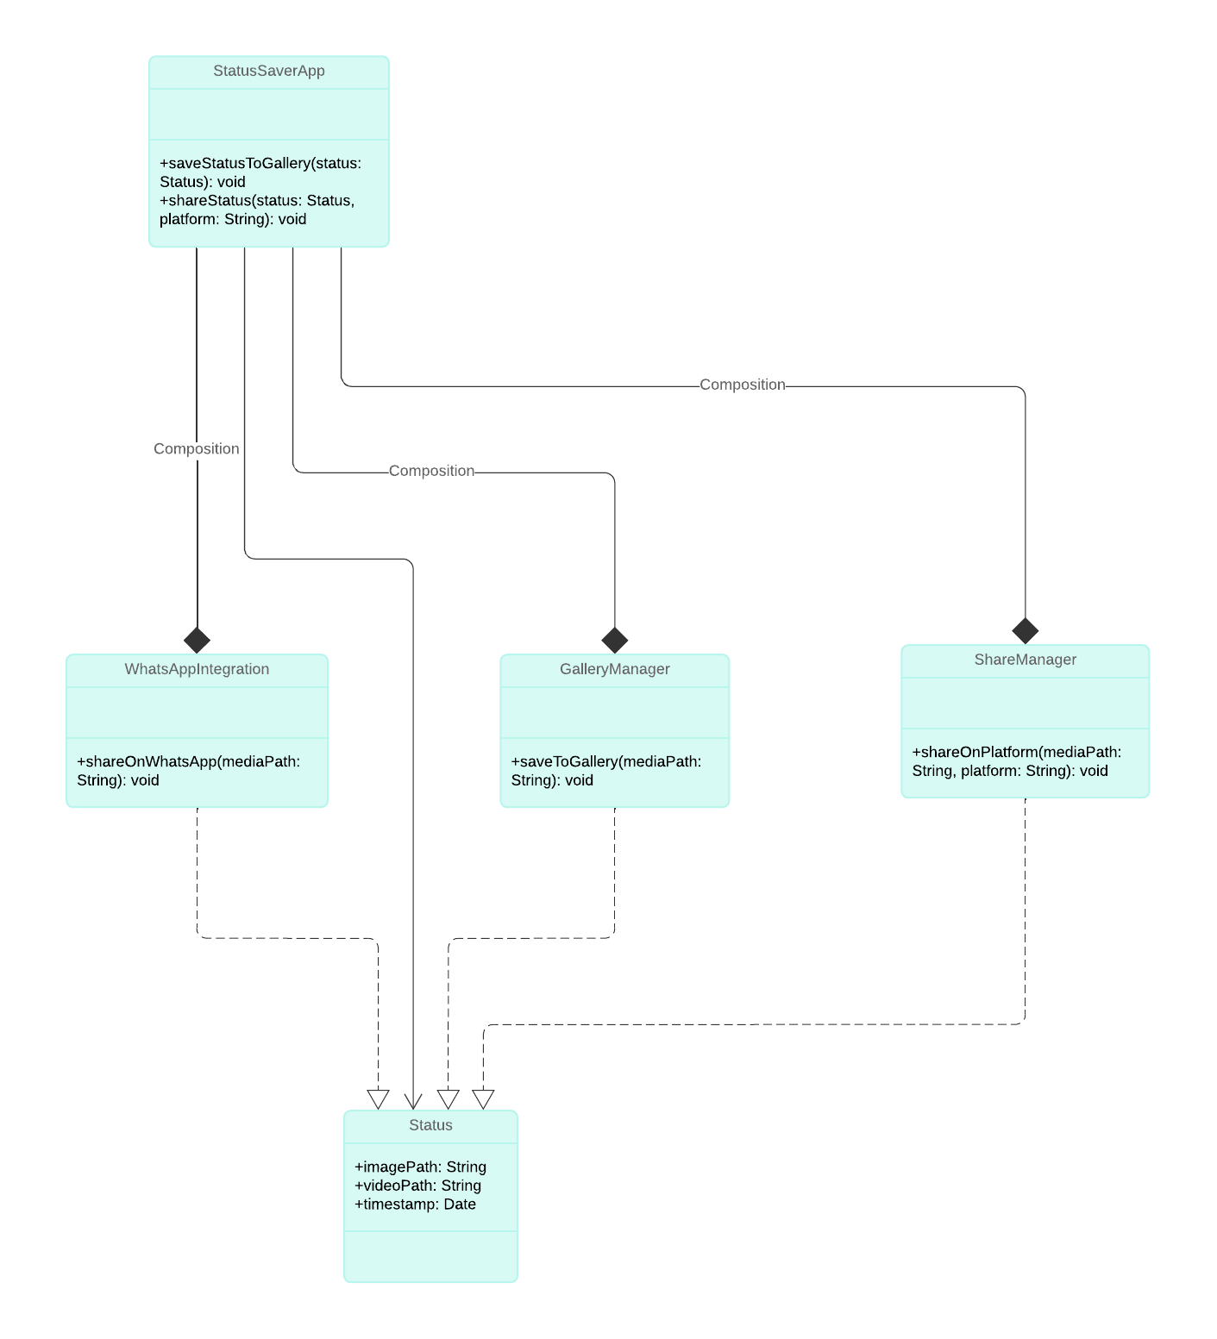
COT-P1 | WhatsApp Status Downloader
Guided by Mr. Mitul Ghediya Silver Oak College Of Engineering and Technology,
College of Technology, SOU
1. Rushikesh Prakashbhai Mistri (2304070100130)
2. Abhishek Dineshbhai Bhavsar (2304070100009)
INTRODUCTION
SYSTEM FLOW with Experiments and Results
WhatsApp statuses are temporary and disappear after 24 hours. Users may want to save these statuses, whether images or videos, for future reference or to share them with others. However, WhatsApp does not provide a built-in feature to save statuses directly, leading to frustration among users who wish to keep or share this content.
GOALS & OBJECTIVES
The primary goal of the WhatsApp Status Saver Downloader Android app is to provide users with a convenient and user-friendly solution to save, view, and share WhatsApp statuses. The app aims to simplify the process of downloading both image and video statuses, offering separate sections for easy navigation. Additionally, it seeks to ensure privacy by requiring minimal permissions, allowing users to save and share content directly from the '.statuses' folder without the need for login or collection of personal data. Ultimately, the app enhances the WhatsApp experience while prioritizing user control and security.
TECHNIQUES USED
Fig 1. Algorithm to execute the MWM
Fig 2 Screeenshots of working app
Programming Language: Kotlin
IDE: Android Studio
Database: No database, uses device storage
Design Patterns: MVVM (Model-View-ViewModel)
Third-party Libraries: Glide for image loading, ViewModel, LiveData for managing UI-related data lifecycle.
IMPLEMENTATION
Implement by publishing Aaplication on playstore
A computer with internet having purchased play console
Add image below of your implementation
ALGORITHM USED
File I/O Operations (for accessing and saving statuses from the '.statuses' folder to the device storage).
Media Playback Algorithms (for previewing video statuses within the app).
RecyclerView Adapter Pattern (to efficiently display and scroll through statuses).
Navigation Algorithms (for handling user navigation between sections like image statuses and video statuses).
FUTURE SCOPE
Cloud backup options for saved statuses.
Scheduled auto-saving of all new statuses.
Additional media management features like deleting saved statuses after a set time.
CLASS DIAGRAM
CONCLUSION
In conclusion, the WhatsApp Status Saver Downloader Android app, developed using Kotlin, offers users a seamless way to download, view, and share WhatsApp statuses. With its intuitive interface, the app categorizes statuses into image and video sections, making it easy to navigate and manage content. Users can effortlessly save statuses to their device gallery and share them across different platforms, including WhatsApp, without the need for login or unnecessary permissions. This app provides a simple yet powerful tool for enhancing the WhatsApp experience while maintaining user privacy and security.
REFERENCES
● Official WhatsApp documentation.
● Android developer documentation on file handling and media access.
● Glide library documentation.

